Slide 1
Fire EI Data Elements / Calculation Stream
Event
Location; start date; growth cessation date; out date; smoldering stopped date
Activity
Acres or tons/day; burn type; fuel type; fuel loading; fuel moisture
FCCS - fuel type & loading; WFAS – fuel moisture; burn type – reporting/permits; spatio/temporal rules
Consumption
Tons burned
BlueSky modeling framework; FOFEM; reporting/permits; assumptions
Emission Factors
Emissions
Mass pollutant/ton burned
Tons pollutant/day
AP-42; Missoula Lab; other references; embedded in consumption/emission calculation frameworks
Sources of Data: Wildfire – SMARTFIRE, ICS209, FRAP (CA); Rx – burn permit databases. Satellite Detects – all types of fire with sufficient heat signature; effort to categorize and cross-check
What aspects are missing?
Should the CM impose basic procedural steps for a WESTAR-WRAP agency to address in contributing to the regional fire inventory?
Starting from EVENTS to build the inventory?
Starting from analysis of an existing EMISSIONS dataset to verify data as estimated?
Require fire type activity characteristics reporting (spatial, temporal, variation in magnitudes)
Can pieces of CM inputs discussed so far be implemented by WESTAR-WRAP agencies given different levels of expertise and resources?
What Subject Matter Experts should we bring in, if any, to flesh out CM?

Slide 2
2 Years
1 Year
6 months
Real-Time
MODIS MCD64A1
HMS
VIIRS AFP
Event
Location; start date; growth cessation date; out date; smoldering stopped date
Activity
Acres or tons/day; burn type; fuel type; fuel loading; fuel moisture
FCCS - fuel type & loading; WFAS – fuel moisture; burn type – reporting/permits; spatiotemporal rules
Consumption
Tons burned
BlueSky modeling framework; FOFEM; reporting/permits; assumptions
Emission Factors
Emissions Inventory
Mass pollutant/ton burned
Tons pollutant/day
AP-42; Missoula Lab; other references; embedded in consumption/emission calculation frameworks
Sources of Data: Wildfire – SMARTFIRE, ICS209, FRAP (CA); Rx – burn permit databases. Satellite Detects – all types of fire with sufficient heat signature; effort to categorize and cross-check
SMARTFIRE v2
FRAP Database
MTBS
Annual Fire Geography
Default Fire Geography
NIFS (InForms)
LANDFIRE Vintage
NASF
FCCS/EVT Grid
NPS
NAWFD
SMP Permits
WFAS fuel moisture
Burn Severity
FINN
CONSUME
SERA
BlueSky Pipeline
FEPS
FOFEM
Level 0
Helper or Enhancer
Level 1
Primary
Data/Tool
Available Components, Timing, Quality
Level 2

Slide 3
2 Years
1 Year
6 months
Real-Time
MODIS MCD64A1
HMS
VIIRS AFP
Event
Location; start date; growth cessation date; out date; smoldering stopped date
Activity
Acres or tons/day; burn type; fuel type; fuel loading; fuel moisture
FCCS - fuel type & loading; WFAS – fuel moisture; burn type – reporting/permits; spatiotemporal rules
Consumption
Tons burned
BlueSky modeling framework; FOFEM; reporting/permits; assumptions
Emission Factors
Emissions Inventory
Mass pollutant/ton burned
Tons pollutant/day
AP-42; Missoula Lab; other references; embedded in consumption/emission calculation frameworks
Sources of Data: Wildfire – SMARTFIRE, ICS209, FRAP (CA); Rx – burn permit databases. Satellite Detects – all types of fire with sufficient heat signature; effort to categorize and cross-check
SMARTFIRE v2
FRAP Database
MTBS
Annual Fire Geography
Default Fire Geography
NIFS (InForms)
LANDFIRE Vintage
NASF
FCCS/EVT Grid
NPS
NAWFD
SMP Permits
WFAS fuel moisture
Burn Severity
FINN
CONSUME
SERA
BlueSky Pipeline
FEPS
FOFEM
Level 0
Helper or Enhancer
Level 1
Primary
Data/Tool
WFEIS Components
Level 2

Slide 4
2 Years
1 Year
6 months
Real-Time
MODIS MCD64A1
HMS
VIIRS AFP
Event
Location; start date; growth cessation date; out date; smoldering stopped date
Activity
Acres or tons/day; burn type; fuel type; fuel loading; fuel moisture
FCCS - fuel type & loading; WFAS – fuel moisture; burn type – reporting/permits; spatiotemporal rules
Consumption
Tons burned
BlueSky modeling framework; FOFEM; reporting/permits; assumptions
Emission Factors
Emissions Inventory
Mass pollutant/ton burned
Tons pollutant/day
AP-42; Missoula Lab; other references; embedded in consumption/emission calculation frameworks
Sources of Data: Wildfire – SMARTFIRE, ICS209, FRAP (CA); Rx – burn permit databases. Satellite Detects – all types of fire with sufficient heat signature; effort to categorize and cross-check
SMARTFIRE v2
FRAP Database
MTBS
Annual Fire Geography
Default Fire Geography
NIFS (InForms)
LANDFIRE Vintage
NASF
FCCS/EVT Grid
NPS
NAWFD
SMP Permits
WFAS fuel moisture
Burn Severity
FINN
CONSUME
SERA
BlueSky Pipeline
FEPS
FOFEM
Level 0
Helper or Enhancer
Level 1
Primary
Data/Tool
CARB Fire EI Components
Level 2

Slide 5
2 Years
1 Year
6 months
Real-Time
MODIS MCD64A1
HMS
VIIRS AFP
Event
Location; start date; growth cessation date; out date; smoldering stopped date
Activity
Acres or tons/day; burn type; fuel type; fuel loading; fuel moisture
FCCS - fuel type & loading; WFAS – fuel moisture; burn type – reporting/permits; spatiotemporal rules
Consumption
Tons burned
BlueSky modeling framework; FOFEM; reporting/permits; assumptions
Emission Factors
Emissions Inventory
Mass pollutant/ton burned
Tons pollutant/day
AP-42; Missoula Lab; other references; embedded in consumption/emission calculation frameworks
Sources of Data: Wildfire – SMARTFIRE, ICS209, FRAP (CA); Rx – burn permit databases. Satellite Detects – all types of fire with sufficient heat signature; effort to categorize and cross-check
SMARTFIRE v2
FRAP Database
MTBS
Annual Fire Geography
Default Fire Geography
NIFS (InForms)
LANDFIRE Vintage
NASF
FCCS/EVT Grid
NPS
NAWFD
SMP Permits
WFAS fuel moisture
Burn Severity
FINN
CONSUME
SERA
BlueSky Pipeline
FEPS
FOFEM
Level 0
Helper or Enhancer
Level 1
Primary
Data/Tool
2014 Fire NEI Components
Level 2

Slide 6
2 Years
1 Year
6 months
Real-Time
MODIS MCD64A1
HMS
VIIRS AFP
Event
Location; start date; growth cessation date; out date; smoldering stopped date
Activity
Acres or tons/day; burn type; fuel type; fuel loading; fuel moisture
FCCS - fuel type & loading; WFAS – fuel moisture; burn type – reporting/permits; spatiotemporal rules
Consumption
Tons burned
BlueSky modeling framework; FOFEM; reporting/permits; assumptions
Emission Factors
Emissions Inventory
Mass pollutant/ton burned
Tons pollutant/day
AP-42; Missoula Lab; other references; embedded in consumption/emission calculation frameworks
Sources of Data: Wildfire – SMARTFIRE, ICS209, FRAP (CA); Rx – burn permit databases. Satellite Detects – all types of fire with sufficient heat signature; effort to categorize and cross-check
SMARTFIRE v2
FRAP Database
MTBS
Annual Fire Geography
Default Fire Geography
NIFS (InForms)
LANDFIRE Vintage
NASF
FCCS/EVT Grid
NPS
NAWFD
SMP Permits
WFAS fuel moisture
Burn Severity
FINN
CONSUME
SERA
BlueSky Pipeline
FEPS
FOFEM
Level 0
Helper or Enhancer
Level 1
Primary
Data/Tool
Idaho DEQ Annual WF EI Components
Level 2

Slide 7
2 Years
1 Year
6 months
Real-Time
MODIS MCD64A1
HMS
VIIRS AFP
Event
Location; start date; growth cessation date; out date; smoldering stopped date
Activity
Acres or tons/day; burn type; fuel type; fuel loading; fuel moisture
FCCS - fuel type & loading; WFAS – fuel moisture; burn type – reporting/permits; spatiotemporal rules
Consumption
Tons burned
BlueSky modeling framework; FOFEM; reporting/permits; assumptions
Emission Factors
Emissions Inventory
Mass pollutant/ton burned
Tons pollutant/day
AP-42; Missoula Lab; other references; embedded in consumption/emission calculation frameworks
Sources of Data: Wildfire – SMARTFIRE, ICS209, FRAP (CA); Rx – burn permit databases. Satellite Detects – all types of fire with sufficient heat signature; effort to categorize and cross-check
SMARTFIRE v2
FRAP Database
MTBS
Annual Fire Geography
Default Fire Geography
NIFS (InForms)
LANDFIRE Vintage
NASF
FCCS/EVT Grid
NPS
NAWFD
SMP Permits
WFAS fuel moisture
Burn Severity
NIFS + HMS for daily WF activity
Point Reports activity
HMS + fire geography for other activity
Consumption & Emissions for #1 and #2 use Consume, fuels DB, moisture
#3 uses FRP for consumption, SERA for emissions
#1 and #2 can use WFEIS, #3 cannot
FINN
CONSUME
SERA
BlueSky Pipeline
FEPS
FOFEM
Level 0
Helper or Enhancer
Level 1
Primary
Data/Tool
CMFD Level 1-2 Fire EI Components
Level 2

Slide 8
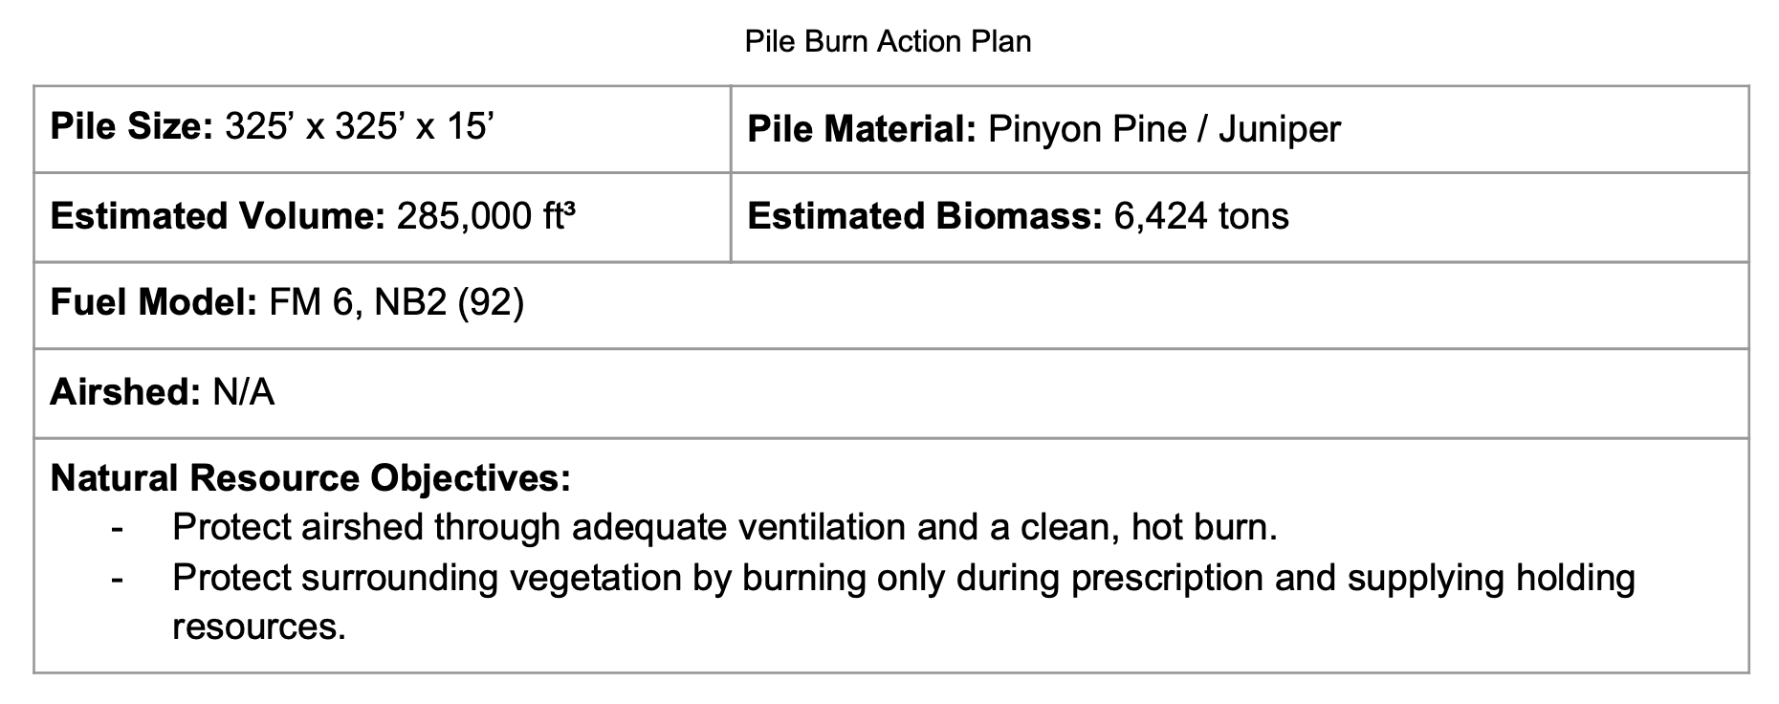
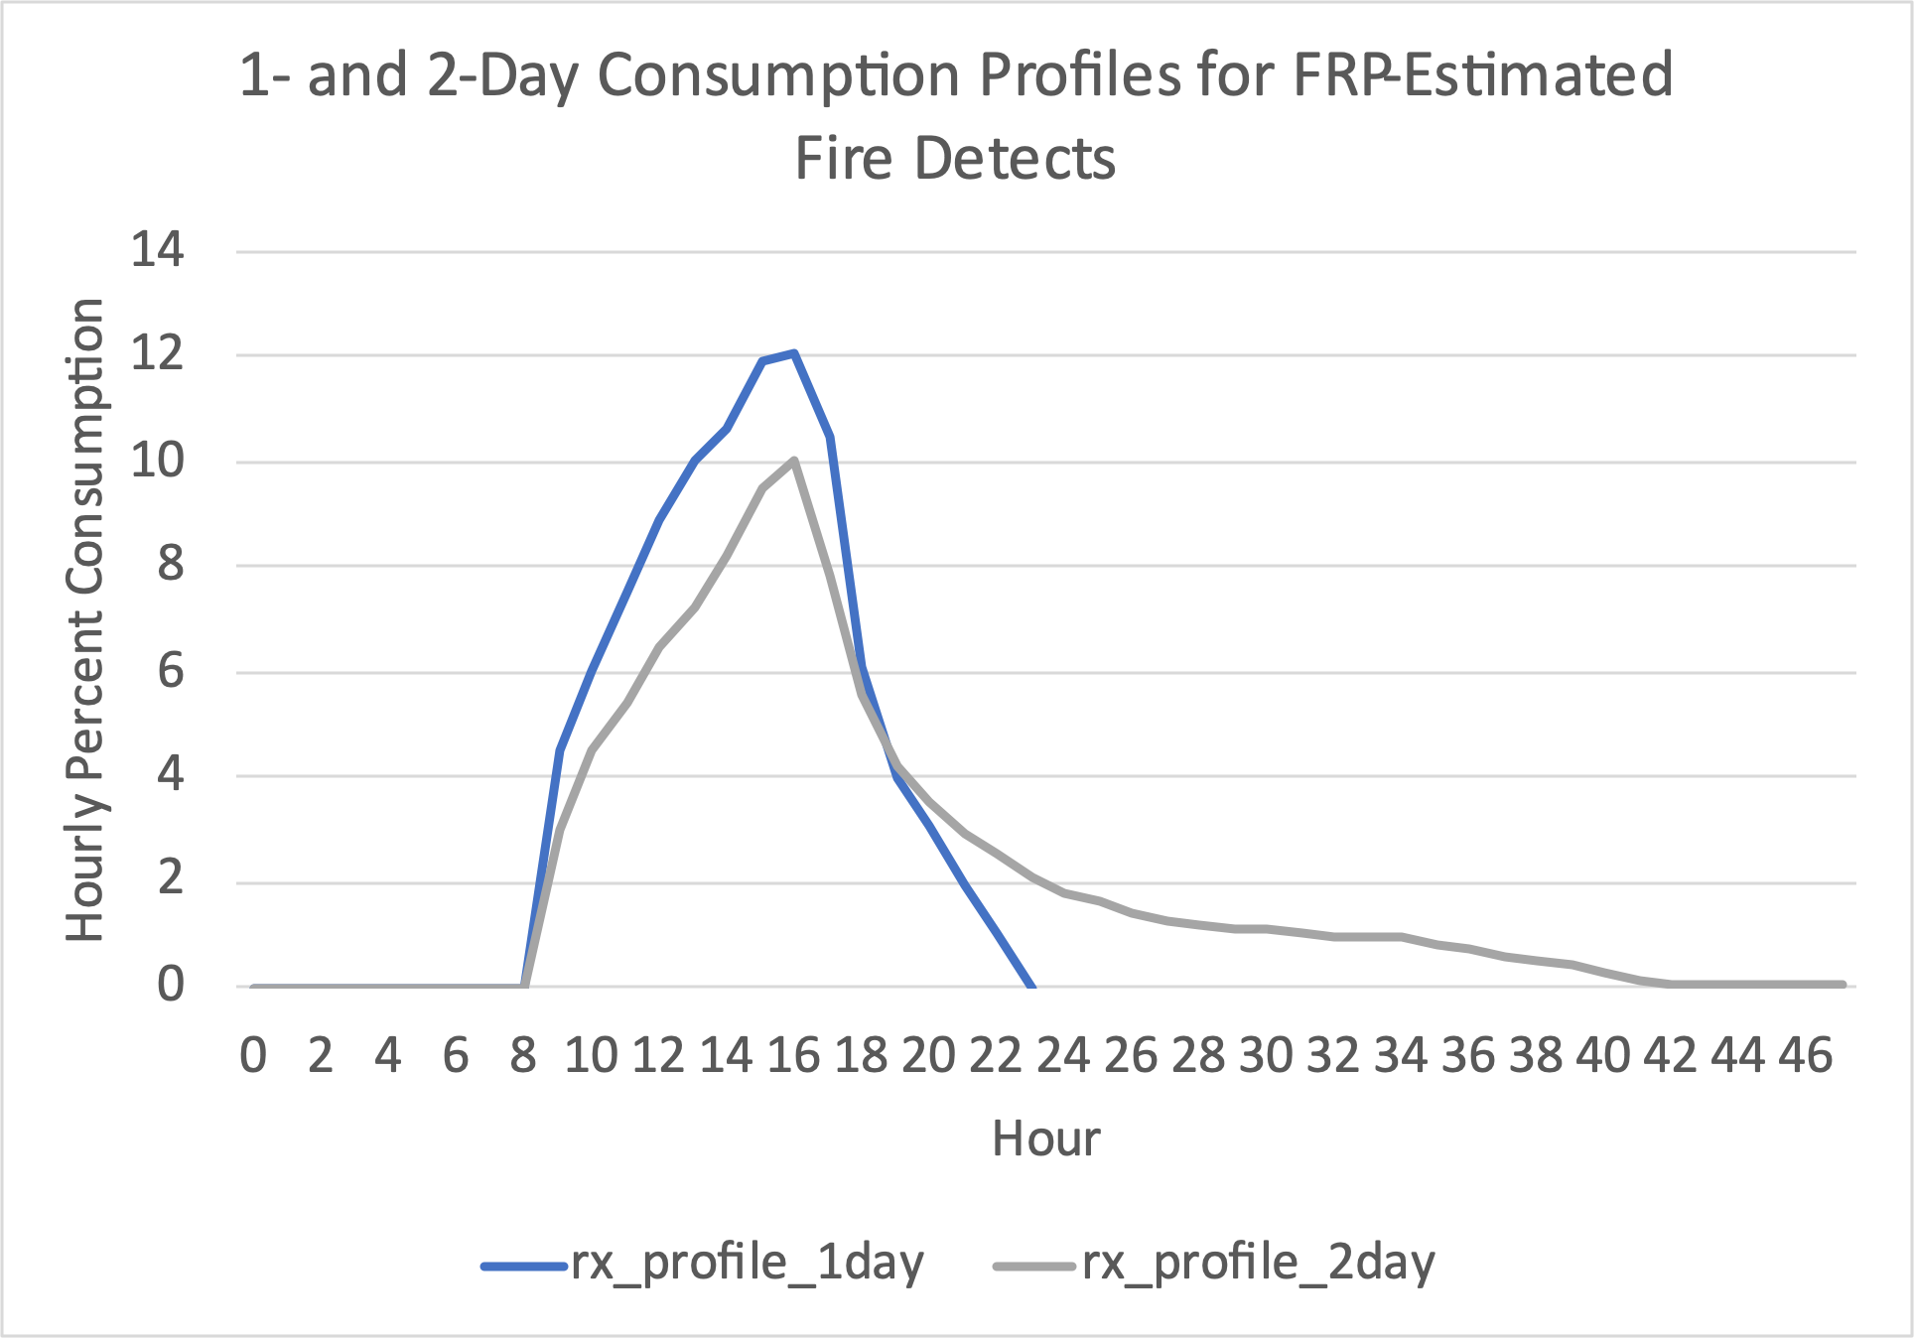
FRP to Tons Consumed Example
Annual Fire Geography
HMS
Known pile burn near Eureka, NV on February 17-18, 2021
0.374 | kg | X |  | ton | = | 0.000412 | ton
 | MJ |  | 907.2 | kg |  |  | MJ
Wooster et al. 2005 Li et al. 2018
3,941 Est. Tons Consumed

Slide 9
Examples from Oregon in 2017
Annual Fire Geography
HMS
Date | Reported Burn Type | Tons Reported | Profile | Tons Derived
10/25/17 | Machine Pile (MP) | 500 | 1-day | 129
10/27/17 | MP | 500 | 2-day | 486
10/30/17 | MP | 400 | 1-day | 302
11/9/17 | MP | 11 | 1-day | 113

Slide 10
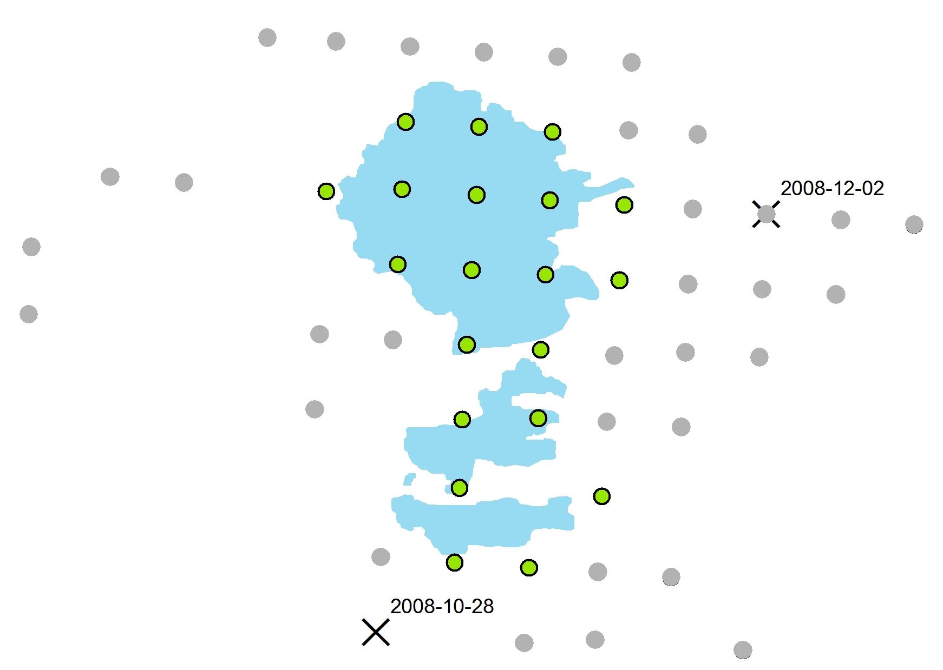
NIFS (InForms)
Annual Fire Geography
HMS
Satellite detections can show the progression of a large fire through time
Final, certified perimeters provide the best estimate of total acres burned
Using detections to directly estimate acres burned can result in large errors
Detections per day can apportion total acres over the life of the burn
Key considerations:
Size of perimeter “catchment”
Determining fire end date
Leverage FRP for severity?

Slide 11
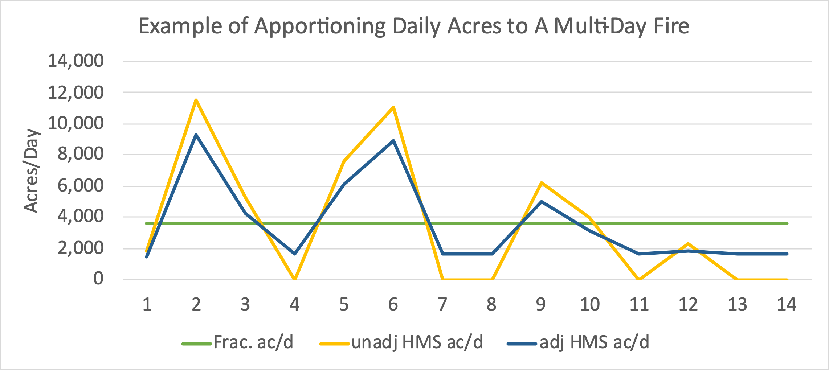
NIFS (InForms)
Annual Fire Geography
HMS
Example Fire (fabricated)
50,000 Acres
Duration: 14 days
Day | 1 | 2 | 3 | 4 | 5 | 6 | 7 | 8 | 9 | 10 | 11 | 12 | 13 | 14
Frac. ac/d | 3,571 | 3,571 | 3,571 | 3,571 | 3,571 | 3,571 | 3,571 | 3,571 | 3,571 | 3,571 | 3,571 | 3,571 | 3,571 | 3,571
HMS/day | 8 | 50 | 23 | 0 | 33 | 48 | 0 | 0 | 27 | 17 | 0 | 10 | 0 | 0
unadj HMS ac/d | 1,852 | 11,574 | 5,324 | 0 | 7,639 | 11,111 | 0 | 0 | 6,250 | 3,935 | 0 | 2,315 | 0 | 0
adj HMS/day | 8 | 50 | 23 | 9 | 33 | 48 | 9 | 9 | 27 | 17 | 9 | 10 | 9 | 9
adj HMS ac/d | 1,296 | 8,102 | 3,727 | 2,500 | 5,347 | 7,778 | 2,500 | 2,500 | 4,375 | 2,755 | 2,500 | 1,620 | 2,500 | 2,500
Divide total acres by days (green)
Apportion based on associated detects (yellow)
Adjust to fill in days with 0 detections
Reapportion acres based on adjusted detects (blue)
Key considerations:
Assessing true time gaps (Weather? Duration?)
Day vs Night detects
Multiple detects at one location in a day

Slide 12
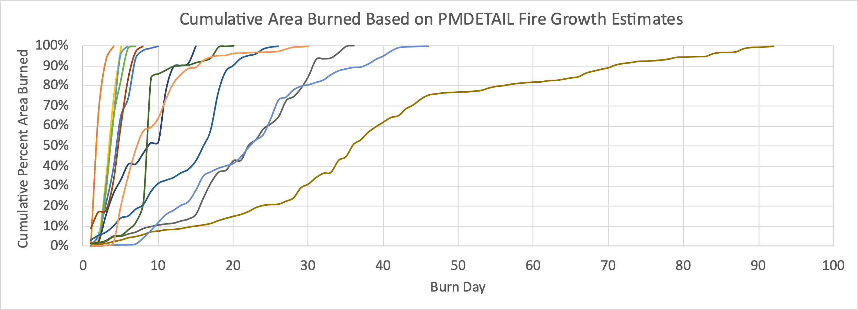
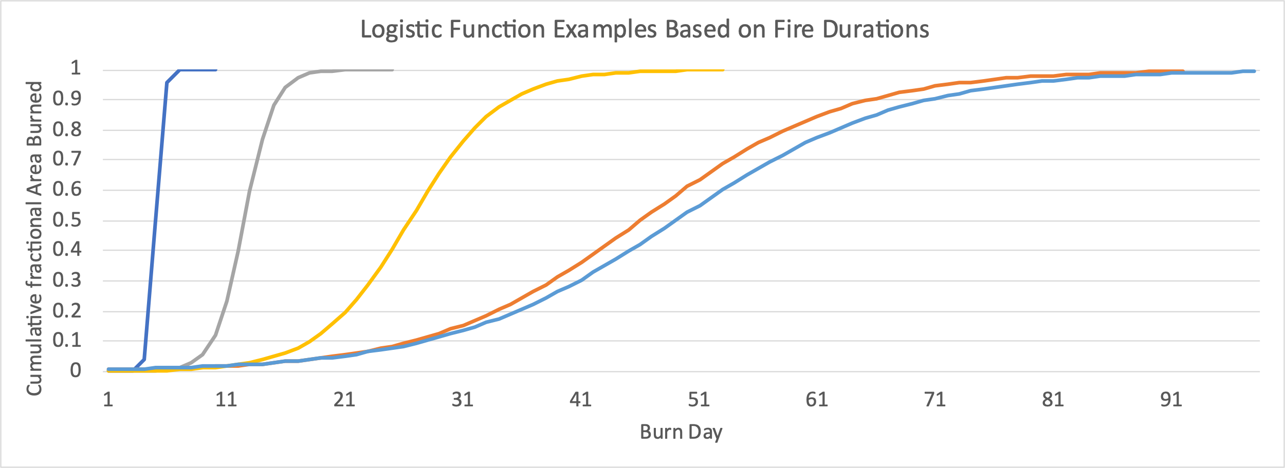
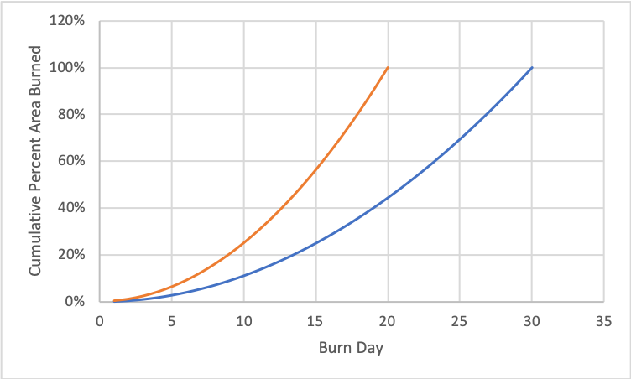
What to do when fire detects are not available for multi-day fires
Actual fire growth based on fire detections…
Modeled fire growth based on logistic function…
Logistic function details…
$$\frac{L}{1+e^{−k\left(x−x_{0}\right)}}$$
L = 1 (max 100% growth)
x = burn day
x₀ = d/2
d = duration of fire
$$k=100d^{−1.5}$$
Fire growth curve in FEPS:

Slide 13
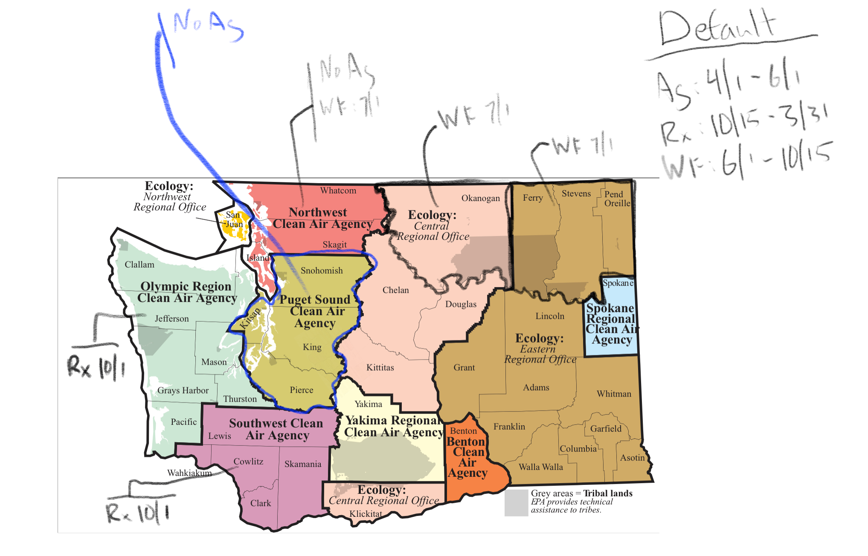
Annual Fire Geography
Fire Geography example

Slide 14
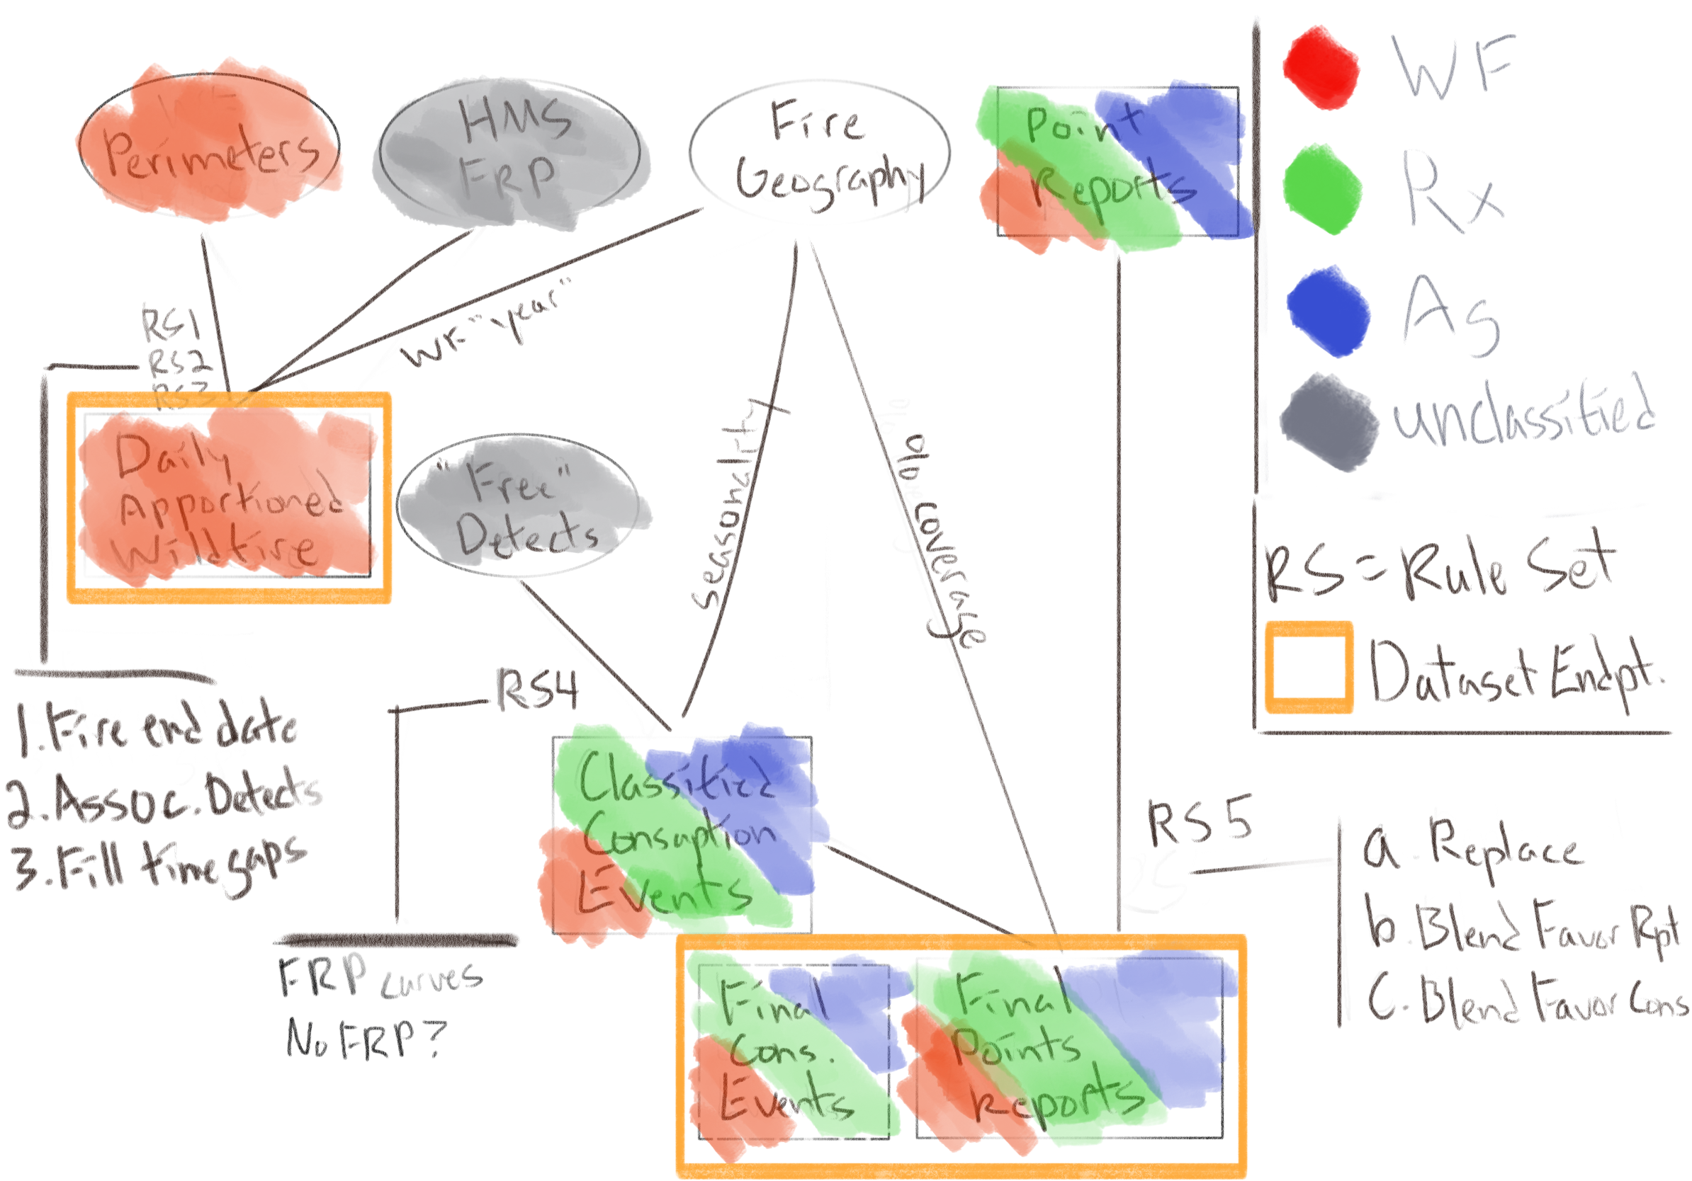
At each point where two or more datasets are combined, one or more rulesets are defined and implemented

Slide 15
Ruleset Examples
Ruleset 4
Ruleset 5

